Slide 1
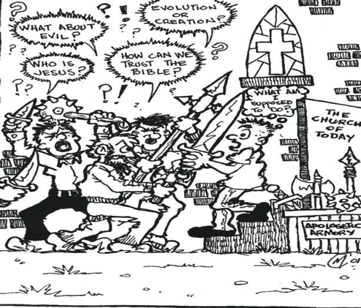

Conversational Apologetics!
By Dr David Geisler
www.meeknessandtruth.org
Notes:
Training Description
- introduce a new paradigm to evangelism
give you the overall concept and some ideas of how to incorporate this
new paradigm into your evangelism, in this first part of the training
- in the second part of the training, you will master the skills that will
create opportunities for pre-evangelism conversations that could lead to
the presentation of the gospel.
Learning Outcomes
- that you will become more effective in evangelism as a result of
incorporating pre-evangelism conversation into your daily witness
- that the first part of these two days of training will result in you
acquiring the skills necessary for pre-evangelism conversation at the
second level of training
Teaching Style
- lectures, trainee participation

Slide 2

Dr. Norman Geisler and
Paul Kurtz
Notes:
2
Instructions for the presenter:
Play the video clip. Instruct those you are teaching to listen carefully to the conversation. Point out that at certain points you will pause the video and ask them to tell you two things.
First, what did you hear them say?
Second, keeping the concepts of Conversational Evangelism in mind, what would you say to them in response?
Note:
The video clip includes markers to lets you know where to pause the video clip.
This video material is included in the Meekness CD in mp4 file format. It is called “Conversational Evangelism in Action (Short).” It also is included in our iPod videos that can be downloaded off of our web-site.
Note:
This video clip is very helpful after you teach the first two concepts (Hearing and Illuminating). It helps people to get a handle on how to use conversational evangelism in real life situations and also gives them practice on becoming a better listener.

Slide 3


2 Cor. 10:5 We demolish arguments and every pretension that sets itself up against the knowledge of God, and we take captive every thought to make it obedient to Christ.
What is the Goal of Using
Apologetics in Evangelism?
Is it to smash down the person?
Notes:
3

Slide 4
What is the Goal of
Apologetics in Evangelism?
“To remove the obstacle so that we can help others take one step close to Jesus Christ every day!
Dr. David Geisler

Slide 5

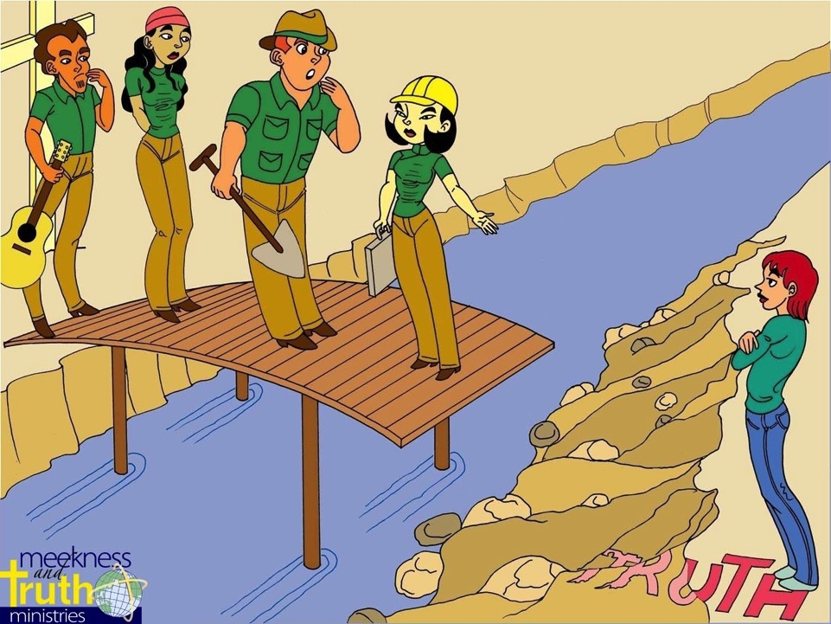

Why Are There So Many Obstacles Today To the Gospel Than Ever Before?
Conversational EVANGELISM
Notes:
5
The problem today is…because of the changing world we live in today there has been an erosion of truth, and because of that it is not so easy for people to build a bridge to the gospel.

Slide 6
Why don’t our skeptical friends
see the world the way we see it?

Slide 7


A World View Shift
“…a major cause of our current crisis consists of a world view shift from a Judeo-Christian understanding of reality to a post-Christian one.”
- J. P. Moreland, Love Your God with All Your Mind, p.21
Notes:
7
J P Moreland in his book Love Your God with All Your Mind says it this way… (read slide)
We now live in a post-modern world. And because of that this is creating problems for us in the whole area of evangelism.

Slide 8
People Are Viewing Reality Through a Fallacious Worldview
Whatever You Believe Is True Is True for You
Christians Are Intolerant
There Is No God, the World Is Full of Evil and Chaos
There Is No Truth
Truth of Christianity
Existence and Attributes of God
Philosophical Foundation

Slide 9
Things To Keep In Mind In Witnessing Today
Remember that they are not the enemy, they are victims of the enemy (2 Cor. 4:4).
Notes:
Training Description
- introduce a new paradigm to evangelism
give you the overall concept and some ideas of how to incorporate this
new paradigm into your evangelism, in this first part of the training
- in the second part of the training, you will master the skills that will
create opportunities for pre-evangelism conversations that could lead to
the presentation of the gospel.
Learning Outcomes
- that you will become more effective in evangelism as a result of
incorporating pre-evangelism conversation into your daily witness
- that the first part of these two days of training will result in you
acquiring the skills necessary for pre-evangelism conversation at the
second level of training
Teaching Style
- lectures, trainee participation

Slide 10
Things To Keep In Mind…
Remember that they are not the enemy, they are victims of the enemy.
Ask the kind of thought provoking questions that could create opportunities for spiritual dialogue.
  • Do you think it is possible we are put here on this earth for some kind of purpose?
  • Do you ever wonder why people like Robin Williams, who did so many good things for others, decided that life wasn’t worth living anymore?
Notes:
Training Description
- introduce a new paradigm to evangelism
give you the overall concept and some ideas of how to incorporate this
new paradigm into your evangelism, in this first part of the training
- in the second part of the training, you will master the skills that will
create opportunities for pre-evangelism conversations that could lead to
the presentation of the gospel.
Learning Outcomes
- that you will become more effective in evangelism as a result of
incorporating pre-evangelism conversation into your daily witness
- that the first part of these two days of training will result in you
acquiring the skills necessary for pre-evangelism conversation at the
second level of training
Teaching Style
- lectures, trainee participation

Slide 11
Things To Keep In Mind…
Remember that they are not the enemy, they are victims of the enemy.
Ask the kind of thought provoking questions that could create opportunities for spiritual dialogue.
  • Do you ever think about the big issues in life?
  • If you were to ask our Creator any question, what do you think it would be?
  • Do you ever get the feeling that our Creator meant for us to experience life in a better way than we are experiencing now?
Notes:
Training Description
- introduce a new paradigm to evangelism
give you the overall concept and some ideas of how to incorporate this
new paradigm into your evangelism, in this first part of the training
- in the second part of the training, you will master the skills that will
create opportunities for pre-evangelism conversations that could lead to
the presentation of the gospel.
Learning Outcomes
- that you will become more effective in evangelism as a result of
incorporating pre-evangelism conversation into your daily witness
- that the first part of these two days of training will result in you
acquiring the skills necessary for pre-evangelism conversation at the
second level of training
Teaching Style
- lectures, trainee participation

Slide 12
Helping Others To Surface
The Truth For Themselves
Interview
with college student
Notes:
12
Instructions for the presenter:
Play the video clip. Instruct those you are teaching to listen carefully to the conversation. Point out that at certain points you will pause the video and ask them to tell you two things.
First, what did you hear them say?
Second, keeping the concepts of Conversational Evangelism in mind, what would you say to them in response?
Note:
The video clip includes markers to lets you know where to pause the video clip.
This video material is included in the Meekness CD in mp4 file format. It is called “Conversational Evangelism in Action (Short).” It also is included in our iPod videos that can be downloaded off of our web-site.
Note:
This video clip is very helpful after you teach the first two concepts (Hearing and Illuminating). It helps people to get a handle on how to use conversational evangelism in real life situations and also gives them practice on becoming a better listener.

Slide 13
Things To Keep In Mind…
Remember that they are not the enemy, they are victims of the enemy.
Ask the kind of thought provoking questions that could create opportunities for spiritual dialogue.
Keep the three D’s in mind in asking questions.
Notes:
Training Description
- introduce a new paradigm to evangelism
give you the overall concept and some ideas of how to incorporate this
new paradigm into your evangelism, in this first part of the training
- in the second part of the training, you will master the skills that will
create opportunities for pre-evangelism conversations that could lead to
the presentation of the gospel.
Learning Outcomes
- that you will become more effective in evangelism as a result of
incorporating pre-evangelism conversation into your daily witness
- that the first part of these two days of training will result in you
acquiring the skills necessary for pre-evangelism conversation at the
second level of training
Teaching Style
- lectures, trainee participation

Slide 14



REMEMBER THE THREE D’S
Is it according to
the Three D’s of Asking Questions?
Doubt
Defensiveness
Desire
Conversational EVANGELISM
Notes:
We also want to ask questions with three objectives in mind in asking questions:
We want to ask questions that surface….
We call this the Three D’s of Asking Questions:
Doubt, Defensiveness, and Desire

Slide 15
Hook Their Interest…
“Jesus answered her, "If you knew the gift of God and who it is that asks you for a drink, you would have asked him and he would have given you living water.”
Jn. 4: 10 N.I.V.

Slide 16
Remember that they are not the enemy, they are victims of the enemy.
Ask the kind of thought provoking questions that could create opportunities for spiritual dialogue.
Keep the three D’s in mind in asking questions.
Determine what kind of evidence isn’t necessary.
Notes:
Training Description
- introduce a new paradigm to evangelism
give you the overall concept and some ideas of how to incorporate this
new paradigm into your evangelism, in this first part of the training
- in the second part of the training, you will master the skills that will
create opportunities for pre-evangelism conversations that could lead to
the presentation of the gospel.
Learning Outcomes
- that you will become more effective in evangelism as a result of
incorporating pre-evangelism conversation into your daily witness
- that the first part of these two days of training will result in you
acquiring the skills necessary for pre-evangelism conversation at the
second level of training
Teaching Style
- lectures, trainee participation

Slide 17
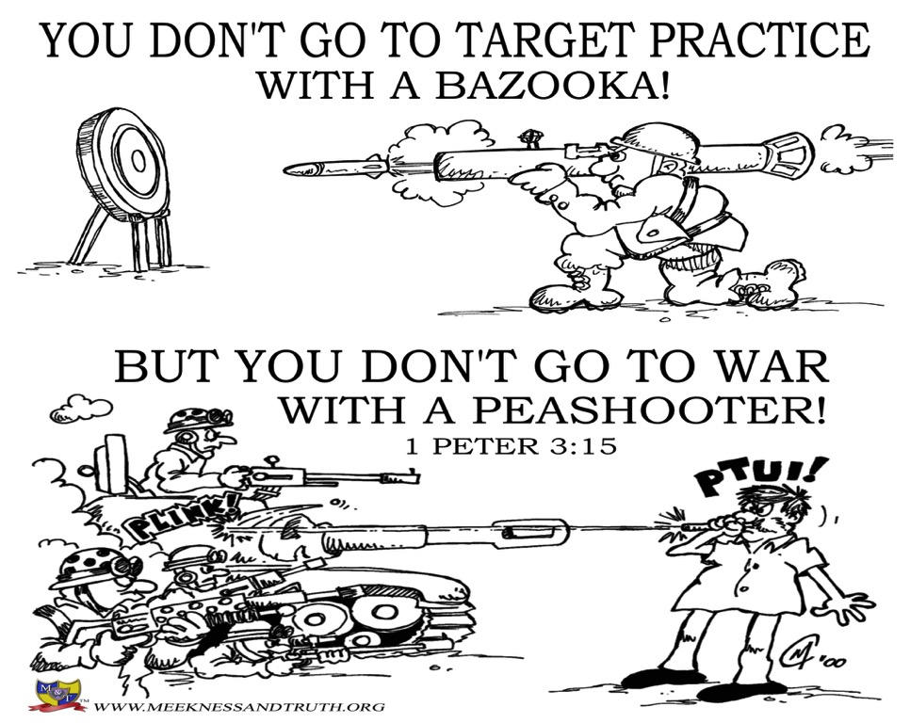

Slide 18
Things To Keep In Mind…
Remember that they are not the enemy, they are victims of the enemy.
Ask the kind of thought provoking questions that could create opportunities for spiritual dialogue.
Keep the three D’s in mind in asking questions.
Determine what kind of evidence isn’t necessary.
* Remember that in the world we live in…less is more!
* Sometimes a softer apologetic approach is better in your first witnessing encounter.
Notes:
Training Description
- introduce a new paradigm to evangelism
give you the overall concept and some ideas of how to incorporate this
new paradigm into your evangelism, in this first part of the training
- in the second part of the training, you will master the skills that will
create opportunities for pre-evangelism conversations that could lead to
the presentation of the gospel.
Learning Outcomes
- that you will become more effective in evangelism as a result of
incorporating pre-evangelism conversation into your daily witness
- that the first part of these two days of training will result in you
acquiring the skills necessary for pre-evangelism conversation at the
second level of training
Teaching Style
- lectures, trainee participation

Slide 19
An Apologetic “Lite” Question…
“If you were coming to the end of your life and you met Jesus and other religious leaders, who’s advice would you take?
Wouldn’t you take the advice of the person who’s been to the other side and come back to tell us about it?

Slide 20

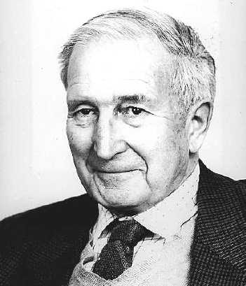
The well-known and outspoken skeptic Anthony Flew changed his mind in 2004. He now is convinced life has been designed.
http://www.youtube.com/watch?v=X1e4FUhfHiU
biologists' investigation of DNA "has shown, by the almost unbelievable complexity of the arrangements which are needed to produce (life), that intelligence must have been involved,"
"It has become inordinately difficult even to begin to think about constructing a naturalistic theory of the evolution of that first reproducing organism,"
if his belief upsets people, well "that's too bad," Flew said. "My whole life has been guided by the principle of Plato's Socrates: Follow the evidence, wherever it leads."
ABC News website, June 19, 2005

Slide 21
Things To Keep In Mind…
Remember that they are not the enemy, they are victims of the enemy.
Ask the kind of thought provoking questions that could create opportunities for spiritual dialogue.
Keep the three D’s in mind in asking questions.
Determine what kind of evidence isn’t necessary.
Help your skeptical friends understand the cost in not believing in God.
Notes:
Training Description
- introduce a new paradigm to evangelism
give you the overall concept and some ideas of how to incorporate this
new paradigm into your evangelism, in this first part of the training
- in the second part of the training, you will master the skills that will
create opportunities for pre-evangelism conversations that could lead to
the presentation of the gospel.
Learning Outcomes
- that you will become more effective in evangelism as a result of
incorporating pre-evangelism conversation into your daily witness
- that the first part of these two days of training will result in you
acquiring the skills necessary for pre-evangelism conversation at the
second level of training
Teaching Style
- lectures, trainee participation

Slide 22
Tearing Down
The Wall of Atheism
Your Response:
“How do we explain where love, meaning, moral values, beauty, and a desire for a purpose come from if we are just effects from material causes?”

Slide 23
Helping Others To Surface
The Truth For Themselves
Interview
with man from Italy on
Daytona Beach
Notes:
23
Instructions for the presenter:
Play the video clip. Instruct those you are teaching to listen carefully to the conversation. Point out that at certain points you will pause the video and ask them to tell you two things.
First, what did you hear them say?
Second, keeping the concepts of Conversational Evangelism in mind, what would you say to them in response?
Note:
The video clip includes markers to lets you know where to pause the video clip.
This video material is included in the Meekness CD in mp4 file format. It is called “Conversational Evangelism in Action (Short).” It also is included in our iPod videos that can be downloaded off of our web-site.
Note:
This video clip is very helpful after you teach the first two concepts (Hearing and Illuminating). It helps people to get a handle on how to use conversational evangelism in real life situations and also gives them practice on becoming a better listener.

Slide 24
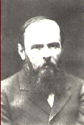
Fyodor Dostoyevsky (1821-1881)
If God is dead, anything is permissible!
The Brothers Karamazov

Slide 25
Things To Keep In Mind…
Remember that they are not the enemy, they are victims of the enemy.
Ask the kind of thought provoking questions that could create opportunities for spiritual dialogue.
Keep the three D’s in mind in asking questions.
Determine what kind of evidence isn’t necessary.
Help your skeptical friends understand the cost in not believing in God.
When building head bridges, don’t forget to build heart bridges also.
Notes:
Training Description
- introduce a new paradigm to evangelism
give you the overall concept and some ideas of how to incorporate this
new paradigm into your evangelism, in this first part of the training
- in the second part of the training, you will master the skills that will
create opportunities for pre-evangelism conversations that could lead to
the presentation of the gospel.
Learning Outcomes
- that you will become more effective in evangelism as a result of
incorporating pre-evangelism conversation into your daily witness
- that the first part of these two days of training will result in you
acquiring the skills necessary for pre-evangelism conversation at the
second level of training
Teaching Style
- lectures, trainee participation

Slide 26
Things To Keep In Mind…
Remember that they are not the enemy, they are victims of the enemy.
Ask the kind of thought provoking questions that could create opportunities for spiritual dialogue.
Keep the three D’s in mind in asking questions.
Determine what kind of evidence isn’t necessary.
Help your skeptical friends understand the cost in not believing in God.
When building head bridges, don’t forget to build heart bridges also.
Help others understand that their primary barrier is really volitional.
Notes:
Training Description
- introduce a new paradigm to evangelism
give you the overall concept and some ideas of how to incorporate this
new paradigm into your evangelism, in this first part of the training
- in the second part of the training, you will master the skills that will
create opportunities for pre-evangelism conversations that could lead to
the presentation of the gospel.
Learning Outcomes
- that you will become more effective in evangelism as a result of
incorporating pre-evangelism conversation into your daily witness
- that the first part of these two days of training will result in you
acquiring the skills necessary for pre-evangelism conversation at the
second level of training
Teaching Style
- lectures, trainee participation

Slide 27
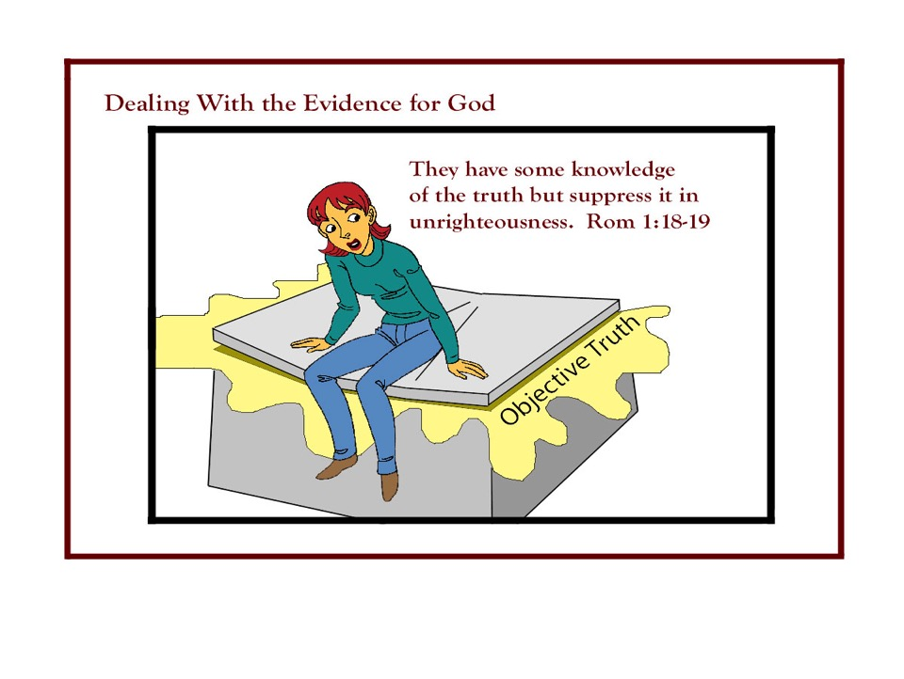
Notes:
Training Description
- introduce a new paradigm to evangelism
give you the overall concept and some ideas of how to incorporate this
new paradigm into your evangelism, in this first part of the training
- in the second part of the training, you will master the skills that will
create opportunities for pre-evangelism conversations that could lead to
the presentation of the gospel.
Learning Outcomes
- that you will become more effective in evangelism as a result of
incorporating pre-evangelism conversation into your daily witness
- that the first part of these two days of training will result in you
acquiring the skills necessary for pre-evangelism conversation at the
second level of training
Teaching Style
- lectures, trainee participation

Slide 28

For the wrath of God is revealed from heaven against all ungodliness and unrighteousness of men, who by their unrighteousness suppress the truth.
For what can be known about God is plain to them, because God has shown it to them..
Romans 1:18-19 (ESV)

Slide 29
For since the creation of the world God's invisible qualities-- his eternal power and divine nature-- have been clearly seen, being understood from what has been made so they are without excuse.
Romans 1:20

Slide 30
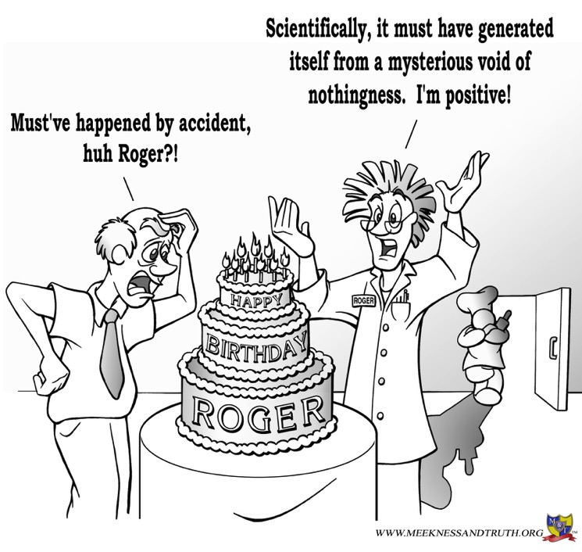
It’s harder to be skeptical today!

Slide 31
The lack of evidence is not
their primary barrier!
Eph. 4:18 says “They are darkened in their understanding, alienated from the life of God because of the ignorance that is in them, due to their hardness of heart (E.S.V.).
Notes:
Training Description
- introduce a new paradigm to evangelism
give you the overall concept and some ideas of how to incorporate this
new paradigm into your evangelism, in this first part of the training
- in the second part of the training, you will master the skills that will
create opportunities for pre-evangelism conversations that could lead to
the presentation of the gospel.
Learning Outcomes
- that you will become more effective in evangelism as a result of
incorporating pre-evangelism conversation into your daily witness
- that the first part of these two days of training will result in you
acquiring the skills necessary for pre-evangelism conversation at the
second level of training
Teaching Style
- lectures, trainee participation

Slide 32
Questions we can use…
Remember that they are not the enemy, they are victims of the enemy.
Ask the kind of thought provoking questions that could create opportunities for spiritual dialogue.
Keep the three D’s in mind in asking questions.
Determine what kind of evidence isn’t necessary.
Help your skeptical friends understand the cost in not believing in God.
When building head bridges, don’t forget to build heart bridges also.
Help others understand that their primary barrier is really volitional.
* So how do we do this?
Notes:
Training Description
- introduce a new paradigm to evangelism
give you the overall concept and some ideas of how to incorporate this
new paradigm into your evangelism, in this first part of the training
- in the second part of the training, you will master the skills that will
create opportunities for pre-evangelism conversations that could lead to
the presentation of the gospel.
Learning Outcomes
- that you will become more effective in evangelism as a result of
incorporating pre-evangelism conversation into your daily witness
- that the first part of these two days of training will result in you
acquiring the skills necessary for pre-evangelism conversation at the
second level of training
Teaching Style
- lectures, trainee participation

Slide 33
Questions we can use with a skeptic
“I believe I can offer you some good reasons to believe that God does exist and that Jesus really is who he claimed to be.
But first let me ask you:
If it were possible for you to know the truth about religious issues would you want to know it.”
“The reason why I ask is because the truth may have consequences you may not really like.”

Slide 34
Follow-up reply…
“I think you may find that even after you get the answers you are looking for, you may find that accepting Jesus is harder than you think?”
“So if you could find a satisfactory answer to what ever troubling questions you have about the Christians faith, does that mean that right now you would invite Christ into your life and give over control of your life from this day forward?”

Slide 35
Questions we can use with a seeker
What is keeping you right now from putting your faith and trust in Christ?

Slide 36
Things To Keep In Mind…
Remember that they are not the enemy, they are victims of the enemy.
Ask the kind of thought provoking questions that could create opportunities for spiritual dialogue.
Keep the three D’s in mind in asking questions.
Determine what kind of evidence isn’t necessary.
Help your skeptical friends understand the cost in not believing in God.
When building head bridges, don’t forget to build heart bridges also.
Help others understand that their primary barrier is really volitional.
Keep the “Five Planks” in mind in your spiritual dialog.
Notes:
Training Description
- introduce a new paradigm to evangelism
give you the overall concept and some ideas of how to incorporate this
new paradigm into your evangelism, in this first part of the training
- in the second part of the training, you will master the skills that will
create opportunities for pre-evangelism conversations that could lead to
the presentation of the gospel.
Learning Outcomes
- that you will become more effective in evangelism as a result of
incorporating pre-evangelism conversation into your daily witness
- that the first part of these two days of training will result in you
acquiring the skills necessary for pre-evangelism conversation at the
second level of training
Teaching Style
- lectures, trainee participation

Slide 37


Building a Bridge Using the Five Planks
Find Common Ground with those you are trying to reach.
Build a bridge from point of shared beliefs (even those they are not quite aware of Rom. 1:20; 2:14-15)
    * A student’s changed perspective after 9/11.
Conversational EVANGELISM

Slide 38
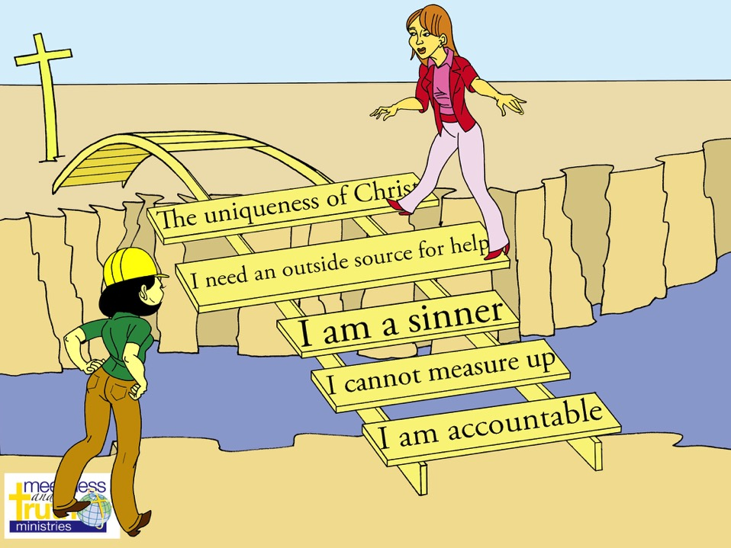

Slide 39
Building a Bridge Using the Five Planks
    Possible transition questions:
    Do you think it is possible we are put here on this earth for some kind of purpose?
    Do you ever wonder why people like Robin Williams, who did so many good things for others, decided that life wasn’t worth living anymore?
    Do you ever think about the big issues in life?
    If you were to ask our Creator any question, what do you think it would be?
    Do you ever get the feeling that our Creator meant for us to experience life in a better way than we are experiencing now?
Conversational EVANGELISM

Slide 40
Transition question to the “Five Planks”
    If I could demonstrate to you that a Creator really did created the world, can you tell me how many of these five planks you would actually agree with?
Conversational EVANGELISM

Slide 41
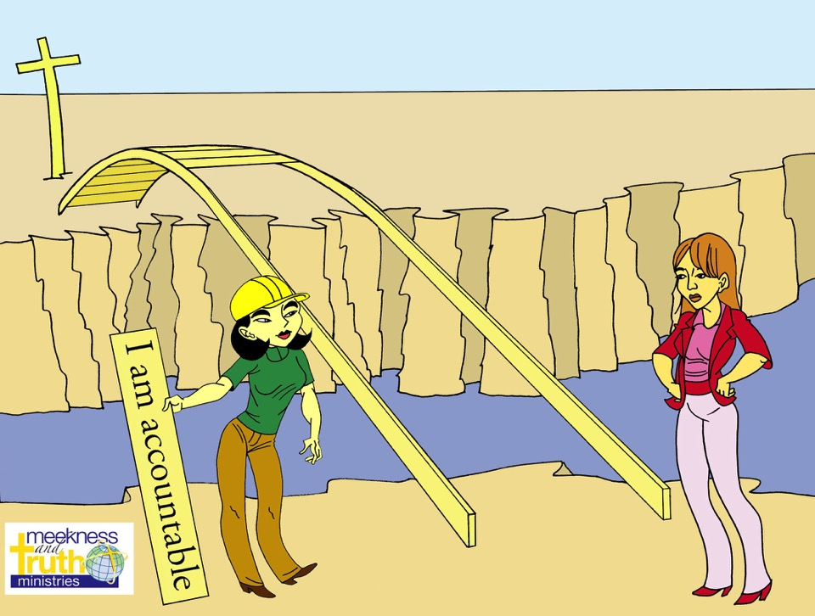

Slide 42

1. We are accountable to our Creator in some way (Romans 14:12).
  We are accountable to our parents as children.
  We are accountable to our teachers in school.
  We are accountable to our boss.
  We are accountable to our government.
  We hope there is some kind of accountability for people like Hitler and Bin Laden or even the group ISIS for their crimes in the next life!
  If we were created, shouldn’t we expect to be accountable in some way to our Creator as well?

Slide 43
Our offense against our Creator
“When we rent a house the landlord effectively gives us their house for our use in whatever way we choose within the boundaries they give us. We have to take care of the house. So for example, we cannot break down the walls.”
“If we do whatever we feel like and break the contract we have with the owner, by destroying the house or parts of it, then we are liable for it.”
Former student IGSL Seminary, Philippines

Slide 44
Our offense against our Creator
“We will be fined or sued. It’s the same with our Creator, even more so with Him. He created the world and put us in it, but he gave us boundaries with which to use what He has given us. We are accountable to Him because everything, including ourselves, belongs to Him!”
Former student IGSL Seminary, Philippines

Slide 45
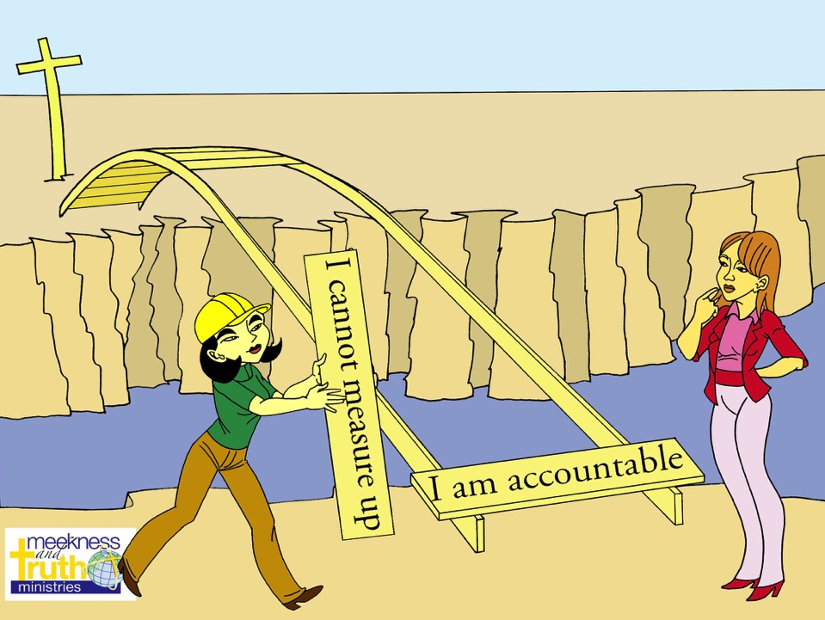

Slide 46
2. We cannot measure up…
Help non-believers surface the truth that our problem is not just that we cannot measure up to God’s standards (Isaiah 64:6; Matt. 4:48; Js. 2:10), the fact is we can’t even measure up to our own standards!

Slide 47
2. We cannot measure up…
It bothers me that I am not a better ______________ to my (children/brother/sister) or a better __________ to my (spouse/parents).
Let me Illustrate this point.

Slide 48

What keeps nonbelievers from cultivating good soil in their lives?
Student’s Question
Why can’t God just let me into heaven?

Slide 49


Theological Truth:
We tend to overestimate our own righteousness and underestimate God’s holiness.
Notes:
49

Slide 50
Sewage, Wedding Dress
Do you see how something can seem so small but in reality still have a huge impact?
Would you agree that our sins could cause a bigger barrier than we think?
Notes:
50

Slide 51
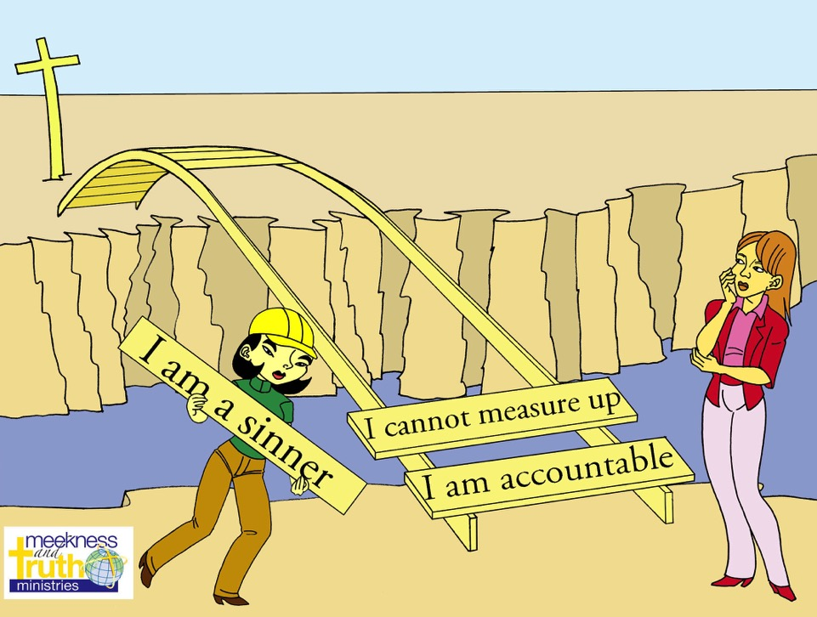

Slide 53
Things To Keep In Mind…
Remember that they are not the enemy, they are victims of the enemy.
Ask the kind of thought provoking questions that could create opportunities for spiritual dialogue.
Keep the three D’s in mind in asking questions.
Determine what kind of evidence isn’t necessary.
Help your skeptical friends understand the cost in not believing in God.
When building head bridges, don’t forget to build heart bridges also.
Help others understand that their primary barrier is really volitional.
Keep the “Five Planks” in mind in your spiritual dialog.
Remember that sometimes it is not even what we say…
it’s our heart for others that can make a
difference.
Notes:
Training Description
- introduce a new paradigm to evangelism
give you the overall concept and some ideas of how to incorporate this
new paradigm into your evangelism, in this first part of the training
- in the second part of the training, you will master the skills that will
create opportunities for pre-evangelism conversations that could lead to
the presentation of the gospel.
Learning Outcomes
- that you will become more effective in evangelism as a result of
incorporating pre-evangelism conversation into your daily witness
- that the first part of these two days of training will result in you
acquiring the skills necessary for pre-evangelism conversation at the
second level of training
Teaching Style
- lectures, trainee participation

Slide 54
Things To Keep In Mind In Witnessing Today
Remember that they are not the enemy, they are victims of the enemy.
Ask the kind of thought provoking questions that could create opportunities for spiritual dialogue.
Keep the three D’s in mind in asking questions.
Determine what kind of evidence isn’t necessary.
Help your skeptical friends understand the cost in not believing in God.
When building head bridges, don’t forget to build heart bridges also.
Help others understand that their primary barrier is really volitional.
Keep the “Five Planks” in mind in your spiritual dialog.
Remember that sometimes it is not even what we say, it’s our heart for others that can make a difference.
Notes:
Training Description
- introduce a new paradigm to evangelism
give you the overall concept and some ideas of how to incorporate this
new paradigm into your evangelism, in this first part of the training
- in the second part of the training, you will master the skills that will
create opportunities for pre-evangelism conversations that could lead to
the presentation of the gospel.
Learning Outcomes
- that you will become more effective in evangelism as a result of
incorporating pre-evangelism conversation into your daily witness
- that the first part of these two days of training will result in you
acquiring the skills necessary for pre-evangelism conversation at the
second level of training
Teaching Style
- lectures, trainee participation

Slide 55
Conversational Apologetics!
By Dr David Geisler
www.meeknessandtruth.org
Notes:
Training Description
- introduce a new paradigm to evangelism
give you the overall concept and some ideas of how to incorporate this
new paradigm into your evangelism, in this first part of the training
- in the second part of the training, you will master the skills that will
create opportunities for pre-evangelism conversations that could lead to
the presentation of the gospel.
Learning Outcomes
- that you will become more effective in evangelism as a result of
incorporating pre-evangelism conversation into your daily witness
- that the first part of these two days of training will result in you
acquiring the skills necessary for pre-evangelism conversation at the
second level of training
Teaching Style
- lectures, trainee participation

